Slide 1
FAKE NEWS
& REAL NEWS
STA 9665, Fall 2020
Team 8
Danny Huang, Nicole Ly, Nishtha Ram, Qinyi Li, Tanay Mukherjee, Trang Le, Xinyi Li

Slide 2
BACKGROUND
01
PREPROCESSING
02
TABLE OF CONTENTS
NLP METHODS
03
04
PRACTICAL
IMPLICATIONS
05
CONCLUSION
Topic Modeling
Text Classification

Slide 3
01
BACKGROUND

Slide 4
BACKGROUND
FAKE NEWS
REAL NEWS
2015 - 2018
2016 - 2017
23,781
21,417
17,903
20,826
0
0
POLITICS, LEFT NEWS, GOVERNMENT NEWS, US NEWS, MIDDLE-EAST, NEWS
WORLD NEWS, POLITIC NEWS
News articles obtained from different sources that were flagged by Polifact and Wikipedia as unreliable
News articles obtained from Reuters
DATE
RECORDS
UNIQUE
NULLS
CATEGORIES
Both datasets contain the following attributes:
TITLE
TEXT
CATEGORY
DATE

Slide 5
MOTIVATION
ABUNDANCE
DIFFICULTY
INFLUENCE
IMPACT
The amount of untruthful information, rumors, and fake news articles have grown significantly
Difficult to identify what the “truth” is as technology advances. With website spoofing, a website is created with the intention of misleading readers
Current technology allows access to new sources through many channels, exponentially increasing the reach of fake news
Fake news is now created with a malicious intent to target a specific audience in the hopes of driving a desired outcome

Slide 6
02
PRE-PROCESSING

Slide 7
DATA CLEANING
Converting date to datetime format
Cleaning the data for processing, e.g. converting to all lowercase, removing links, line breaks, etc.
Join both the Fake News and Real News dataset into one and tag the fake news as 0 and real news as 1
DATE
CLEAN
JOIN
PARSE
STOP
WORDS
Parsing out the publisher data embedded within the text
Removing words that will not add value to the NLP analysis

Slide 8
Data Processing
Methods
Feature
Extraction
Named
Entity Recognition
N-Gram
Analysis

Slide 9
03
NLP METHODS
Topic Modeling
Text Classification

Slide 10
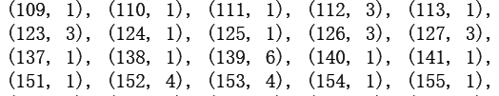
Understanding Topic Modeling
What is Topic Modeling?
Unsupervised learning method
Represent the documents as a set of abstract "topics"
Why we use Topic Modeling?
Have a general understanding of news dataset
Figure out the topic of news without reading it word by word
How we do LDA Topic Modeling?
Packages: gensim, spacy and pyLDAvis
LDA model:
Dictionary: single words, bigrams and trigrams
Corpus: document-term matrix
Optimal number of topics: 7

Slide 11
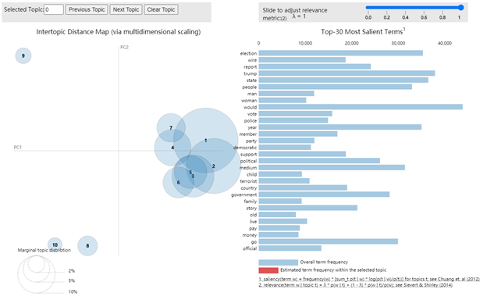
TOPIC MODELING - Results（10 topics）
After we have everything required to train the LDA model, we first train the model with 10 topics and we get the result as follows:

Slide 12
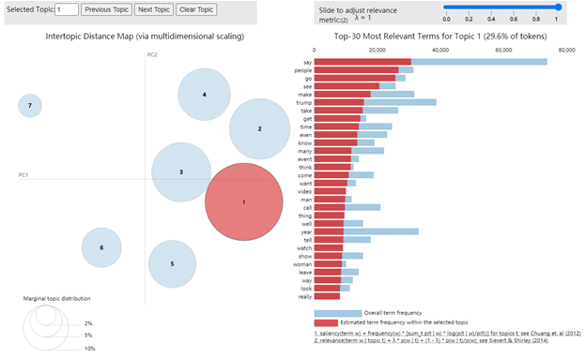
TOPIC MODELING - Results（7 topics）
We experimented with 5, 6, 7, 8 and 9 topics respectively. After analyzed the data, we selected 7 topics as it the best we can get to meet “between having too many topics to be interpretable and too few to allow meaningfully variation” (Haans, 2019: 13)”

Slide 13
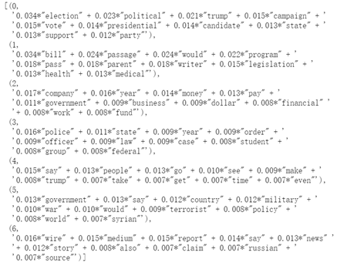
TOPIC MODELING - Topwords & Topics
Each topic in LDA model is a combination of topwords and each topword contributes a certain weightage to the topic.
Topic 0 | Presidential Election
Topic 1 | Bill and Legislation
Topic 2 | Economy
Topic 3 | Police
Topic 4 | People Action
Topic 5 | War and Military
Topic 6 | News Media

Slide 14
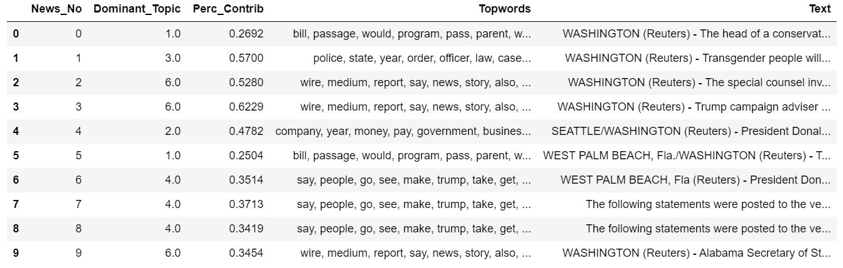
TOPIC MODELING - Results Testing
After building the topic model, we could determine the topic of a given news document. We chose the topic number with the highest percentage contribution. The table below was the dominant topic for some documents. For example, the most likely topic of the news with number 0 was bill and legislation.

Slide 15
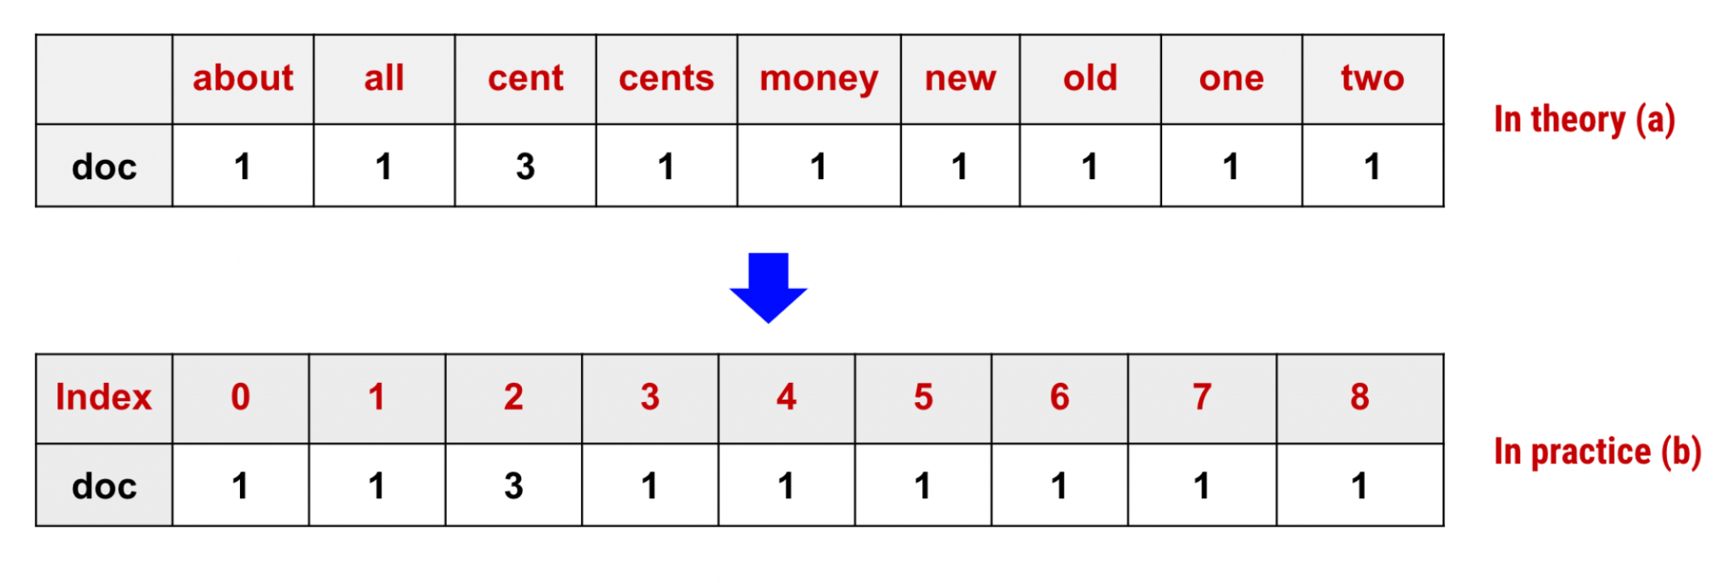
Understanding Count - Vectorization
Before we proceed with classification, we need to clarify what features are considered in the prediction of classes, either fake or real news. Since the news articles are text based documents, the most common features can be extracted from text documents are words used and their individual frequency or occurrence.
Example:
doc=["One Cent, Two Cents, Old Cent, New Cent: All About Money"]

Slide 16
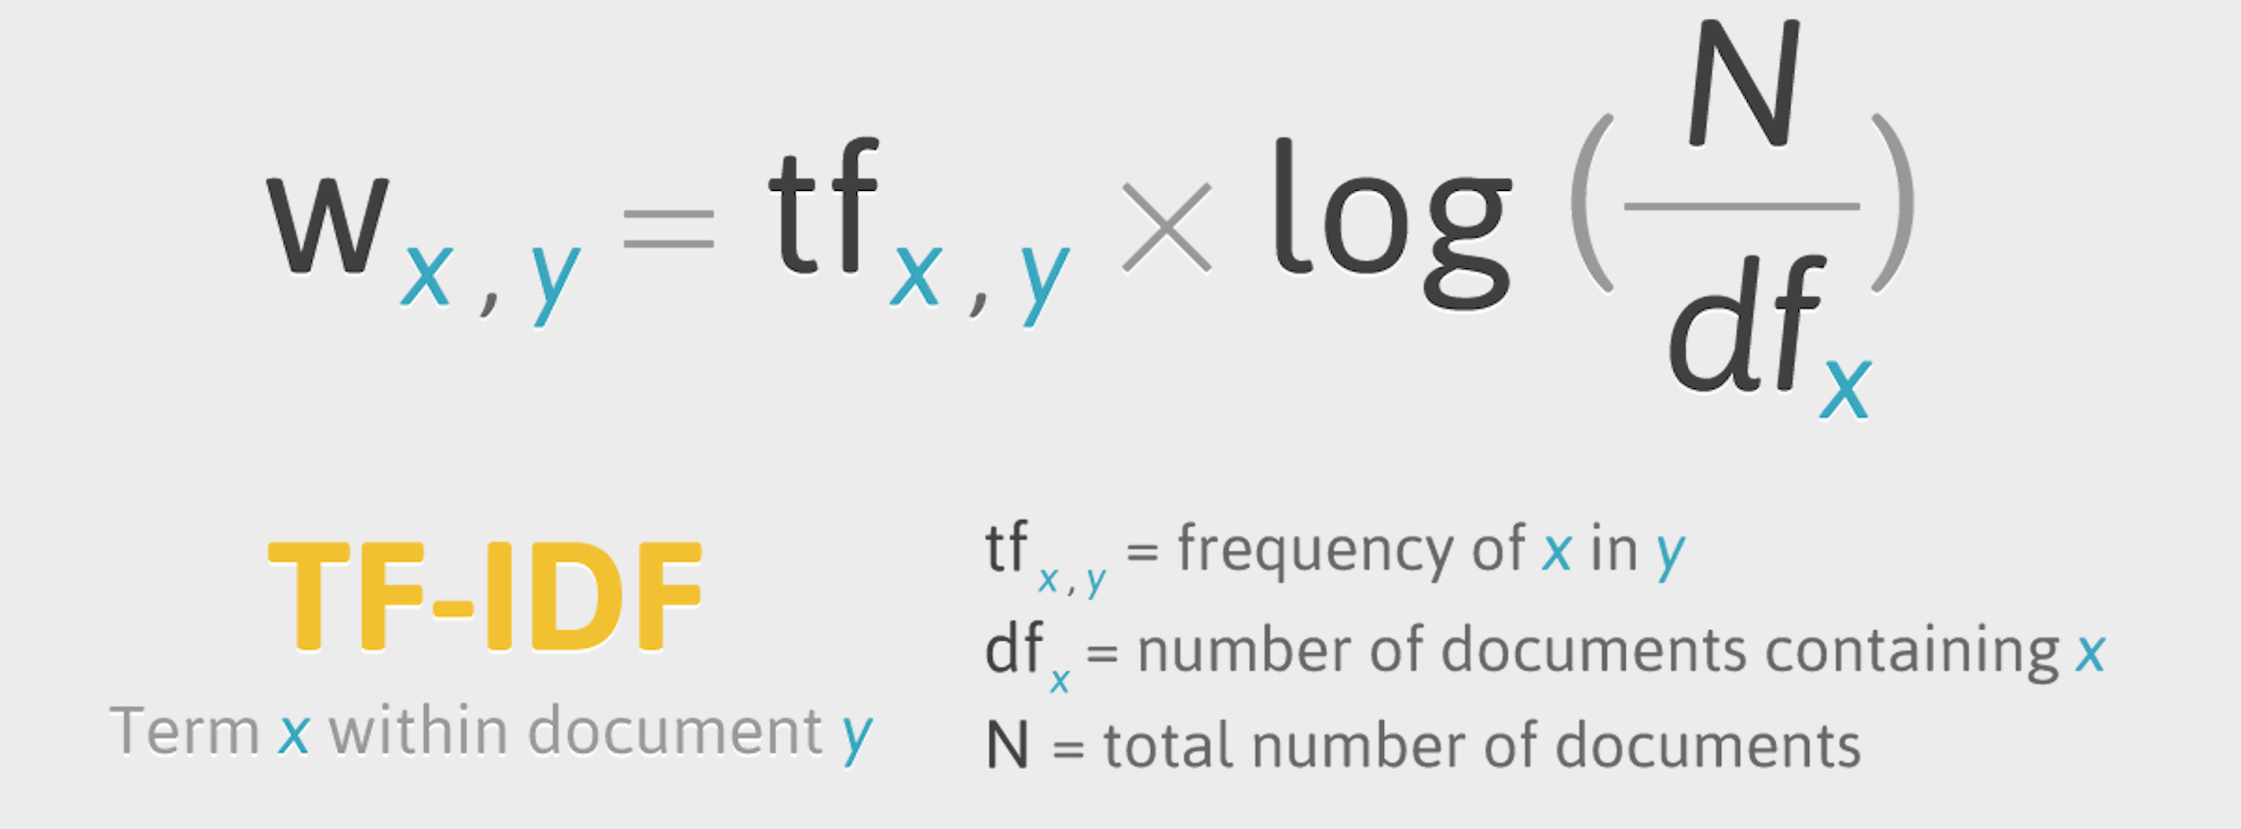
Understanding TF - IDF
TF-IDF, short for “term frequency–inverse document frequency”, is a numerical statistic that is intended to reflect how important a word is to a document in a collection or corpus.
It is often used as a weighting factor in searches of information retrieval and text mining. The tf–idf value increases proportionally to the number of times a word appears in the document and is offset by the number of documents in the corpus that contain the word, which helps to adjust for the fact that some words appear more frequently in general.

Slide 17
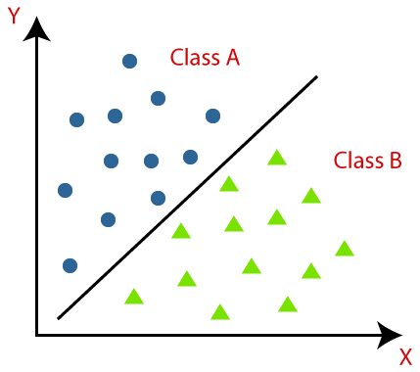
Classification and model selection
Once the features were ready having done the data pre-processing and the required steps before feeding in the data for modeling, we decided to conduct the classification exercise using various models. Following are the models we decided to experiment with and based on the model which gives us the best accuracy we will hyper-parameterize it.
Models for classification:
Logistic Regression
Decision Tree Classifier
Random Forest Classifier
Naive Bayes Classifier
KNN

Slide 18
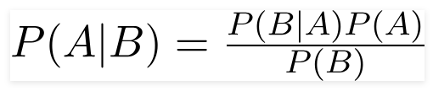
Understanding each model
Logistic Regression: This is a statistical model that in its basic form uses a logistic function to model a binary dependent variable. In a binary logistic regression model, the dependent variable has two levels (categorical).
Decision Tree Classifier: It is a simple representation for classifying examples. It is a Supervised Machine Learning where the data is continuously split according to a certain parameter. For classification, a tree is built through a process known as binary recursive partitioning. This is an iterative process of splitting the data into partitions, and then splitting it up further on each of the branches.
Random Forest Classifier: Decision trees we learnt above is the base for this statistical model. It consists of a large number of individual decision trees that operate as an ensemble. The principle behind this model is - “a large number of relatively uncorrelated models (trees) operating as a committee will outperform any of the individual constituent models”.
Naive Bayes Classifier: A Naive Bayes classifier is a probabilistic machine learning model that’s used for classification task. The crux of the classifier is based on the Bayes theorem.
Using Bayes theorem, we find the probability of A happening, given that B has occurred. Here, B is the evidence and A is the hypothesis. The assumption here is that the predictors/features are independent, i.e., presence of one particular feature does not affect the other.
KNN: K-nearest neighbors is a supervised machine learning algorithm that can be used to solve both classification and regression tasks. In this statistical model the value of a data point is determined by the data points around it. KNN classifier determines the class of a data point by majority voting principle. If k is set to 3, the classes of 3 closest points are checked. Prediction is done according to the majority class. Similarly, kNN regression takes the mean value of 3 closest points.

Slide 19
Comparison of Model Performance
Recall = percentage of the actual fake news are classified as fake news
Presion = percentage of the classified fake news are actually fake news
Metrics | Logistic regression | Decision Tree Classifier | Random Forest Classifier | Naive Bayes | KNN (k=3)
Accuracy | 98.66% | 95.79% | 98.60% | 93.92% | 69.12%
Recall | 98.90% | 96.58% | 98.65% | 95.31% | 98.22%
Precision | 98.57% | 95.49% | 98.69% | 93.3% | 63.36%
F-measure | 98.73% | 96.03% | 98.67% | 94.29% | 77.03%

Slide 20
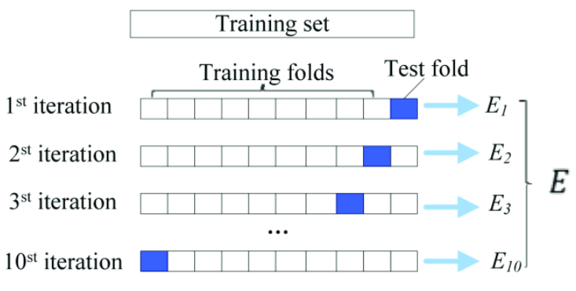
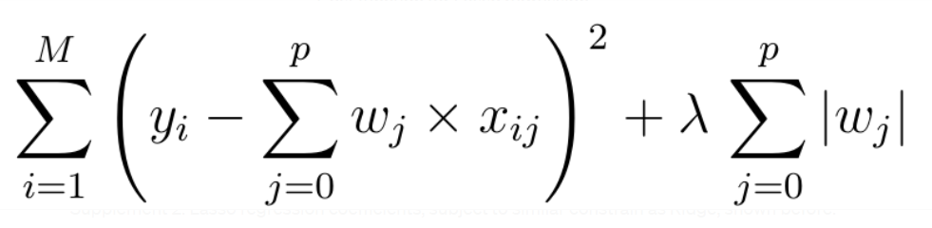
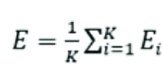
Regularized Logistic Regression - I
Why do we need this for regression?
underdetermined system of linear equations
caused by having more features than observations/training data points.
M = 44,888 and P = 121,981
Y = w₁X₁ + w₂X₂
Prevention of overfitting
How do we apply regularization?
Addition of “penalty term” to our objective function
Choose the optimal penalty value by performing 10-fold Cross Validation

Slide 21
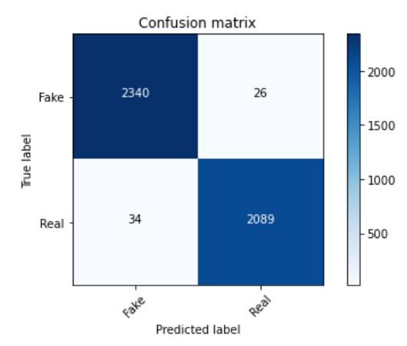
Regularized Logistic Regression - II
Result?
Better performance
Less likely to overfit
Accuracy | Recall | Precision | F-measure
99.29% | 99.45% | 99.20% | 99.32%

Slide 22
04
PRACTICAL IMPLICATIONS

Slide 23
INFORMATION SHAPES HOW WE VIEW THE WORLD AND
INFLUENCES OUR DECISION MAKING
REAL WORLD IMPLICATIONS
OF FAKE NEWS
SOCIAL MEDIA
ELECTION
Misinformation and conspiracy theories spread like wildfire
Misinformation about voting fraud
COVID-19
Misinformation about the origins of COVID-19 and treatments
FINANCIAL IMPACTS
HEALTH IMPACTS
FEAR
RACISM
VIOLENCE
POLITICAL IMPACTS
DISTRUST

Slide 24
05
CONCLUSION

Slide 25
A Quick Recap
Data Pre-processing:
NER: Fake news (Trump, Finicum, Syria, War) vs Real news (Trump, Mueller, US, Hurricane Maria)
Topic Modeling:
LDA Model: 7 topics model with coherence score of 0.45 (Presidential Election, Bill and Legislation, Economy, Police, People Action, War and Military, News Media)
Text Classification
Model Building: Logistic Regression, Decision Tree Classifier, Random Forest Classifier, Naive Bayes, KNN, Regularized Logistic Regression
Model Selection: Regularized Logistic Regression with accuracy score of 99.29%

Slide 26
THANK YOU

Slide 27
APPENDIX

Slide 28
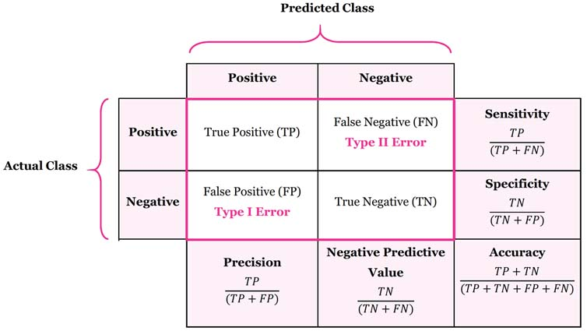
Understanding Confusion Matrix
Confusion matrix is another metric that is often used to measure the performance of a classification algorithm. True to its name, the terminology related to the confusion matrix can be rather confusing, but the matrix itself is simple to understand

